Slide 1
Transmitter Localization and Optimizing Initial State in Classical/Quantum Sensor Networks
Thesis Defense – Jan. 23, 2024
Caitao Zhan
Committee: Himanshu Gupta, Samir Das, C.R. Ramakrishnan, Nengkun Yu, Mark Hillery

Slide 2
Table of Contents
Content | Paper | Time
Part 0: Introduction & Motivation |  | 8 min
Part 1: Transmitter Localization in classical sensor networks | ACM/IEEE IPSN 2020 IEEE WoWMoM 2021 Elsevier PMC 2022 | 16 min
Part 2: Transmitter Localization in quantum sensor networks | IEEE QCE 2023 | 14 min
Part 3: Optimizing Initial State in quantum sensor networks | ACM TQC (under revision) | 14 min
Summary

Slide 3
RF spectrum
Electromagnetic spectrum with frequencies from 3 Hz to 3000 GHz
Sweet spot: hundreds of MHz to a few GHz
Limited natural resource in great demand due to increasing number of wireless devices

Slide 4
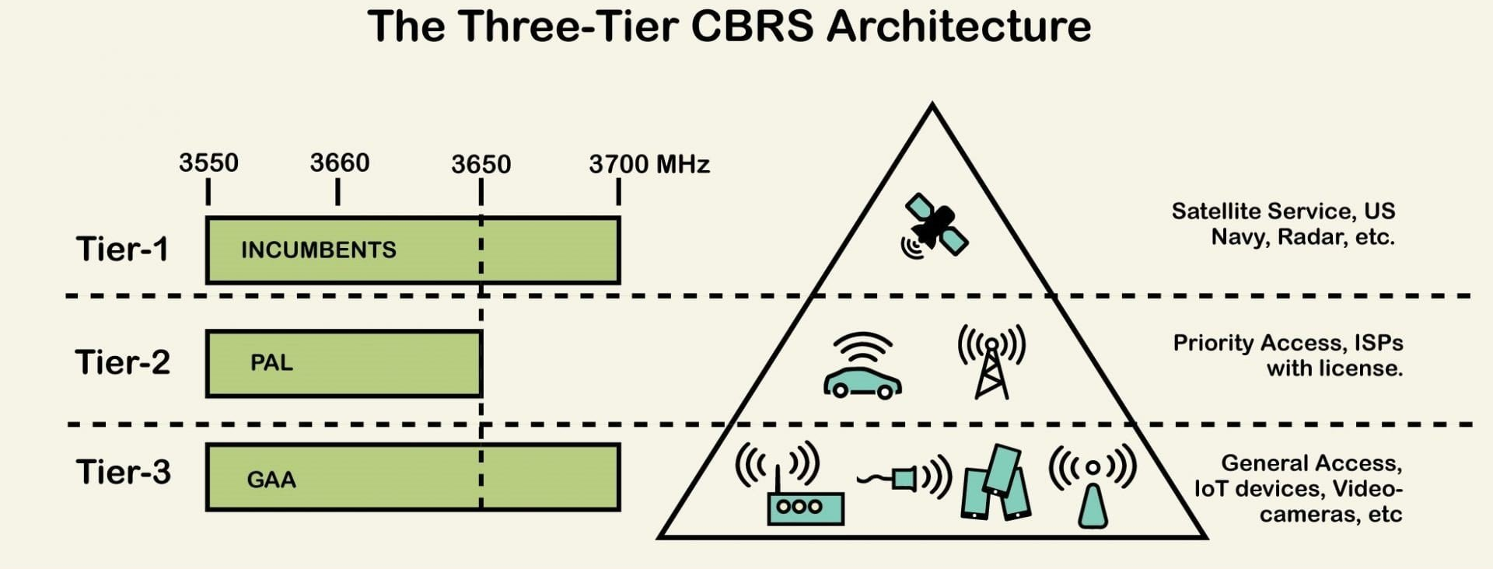
Shared Spectrum
Authorized user: users with license, incumbents (highest priority)
Unauthorized user: users without license. Use spectrum opportunistically
Should not affect authorized users

Slide 5
Problem -- Interference
Problem: Unauthorized users (intruders) transmitting illegally will interfere against the authorized users
Bad Solution: Detect spectrum violations via complaints and manual investigation
Human intensive and time-consuming
Motivated by the above, we seek an effective way to accurately localize multiple intruders simultaneously – Multiple transmitter localization (MTL)

Slide 6
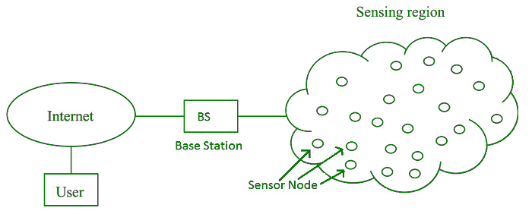
Wireless Sensor Networks (WSN)
MTL via Classical Sensor Networks
Intruders

Slide 7
Classical vs. Quantum Sensor
Classical sensor
Quantum sensor
Wireless sensor: RSS, CSI
Image sensor: visible light
Acoustic sensor: sound wave
Single photon detector: single photon
RF-photonic sensor: optical quadrature displacement
Interferometry: light phase change
Rydberg atoms: electric field
Sensitivity:
above standard quantum limit
Sensitivity:
below standard quantum limit
Notes:
The SQL arises from the Heisenberg uncertainty principle, [which states that there is a fundamental limit to the precision with which pairs of properties, such as position and momentum, can be simultaneously known]
SQL refers to the minimum level of quantum noise without using entanglement and squeezed states.

Slide 8
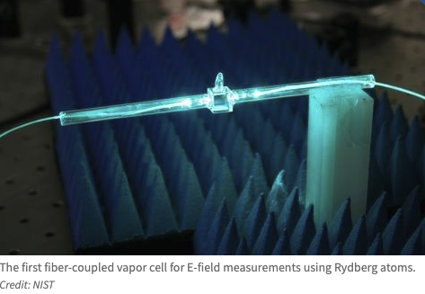
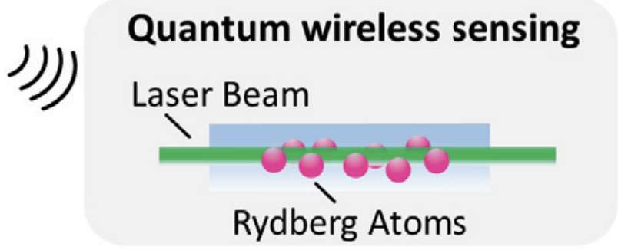
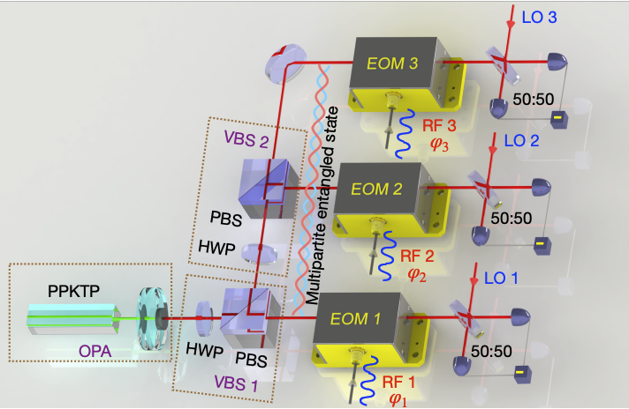
Why Quantum Sensor?
Advances in quantum technologies $→$ efficient and sensitive quantum sensors for radio-frequency (RF) sensing
Rydberg atom-based spectrum analyzer [1]: 0 to 20 GHz
Quantum wireless sensing [2]: micro energy level of atoms $→$ vibration of water
RF-photonic quantum sensors [3]: optics property $→$ amplitude/phase of radio signal
[1] Waveguide-coupled Rydberg Spectrum Analyzer from 0 to 20 GHZ, D. Meyer et al, PR Applied 2023
[2] Quantum Wireless Sensing: Principle, Design, and Implementation, F. Zhang et al, MobiCom 2023
[3] Demonstration of a reconfigurable entangled radiofrequency photonic sensor network, Z. Zhang et al, RPL 2020
Notes:
much more sensitive than the classical antenna-based RF sensors.

Slide 9
Table of Contents
Content | Paper | Time
Part 0: Introduction & Motivation |  | 8 min
Part 1: Transmitter Localization in classical sensor networks | ACM/IEEE IPSN 2020 IEEE WoWMoM 2021 Elsevier PMC 2022 | 16 min
Part 2: Transmitter Localization in quantum sensor networks | IEEE QCE 2023 | 14 min
Part 3: Optimizing Initial State in quantum sensor networks | ACM TQC (under revision) | 14 min
Summary

Slide 10
Part 1.1 -- Efficient Localization of Multiple Intruders in Shared Spectrum Systems (IPSN 2020)
Location?
Sensor
Authorized user
Location?
Intruder
Intruder
Authorized user
Sensor
Notes:
Consider a geographic area, some authorized users
Crowdsourced a lot of sensors. Sensors report RSS
Three types of transmitters: Primary, secondary, intruders.

Slide 11
Problem Definition
MTL-SS: given the observations from the sensors, locate the intruders
Challenges:
Sensor receives only an aggregated sum of the signals from the multiple intruders transmitting simultaneously. Signal assume not-separatable
Multiple targets to localize, some might be close to each other.
Dynamically changing authorized users in the background.
MTL: not considering background authorized users
Background authorized user issue can be solved using online training technique

Slide 12
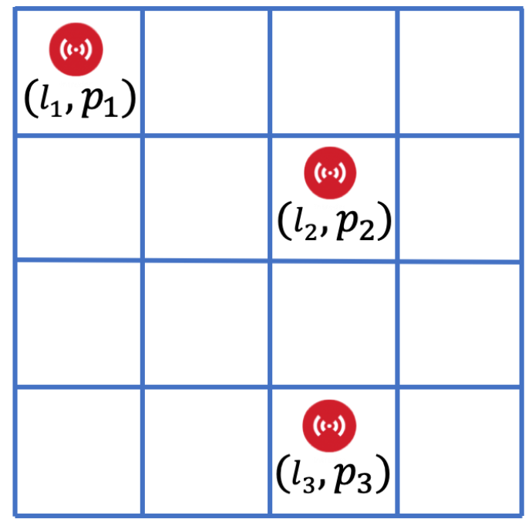
High-level Approach: Maximum a Posterior (MAP)
A hypothesis $H_{i}$is a configuration of intruders, a set of (location, power) pairs.
Training data: Probability distributions (PDs) of RSS at sensor locations for each hypothesis
MAP: Given actual sensor observations of RSS, compute the following Bayes formula and pick the most likely hypothesis
PD from training data
actual observation
A single hypothesis
$$P\left(H_{i} | X\right)= \frac{P\left(X \right|{ H}_{i}) P(H_{i})}{\sum_{j=1}^{m}{P(X | H_{j})} P(H_{j})}$$

Slide 13
Pros & Cons of MAP
Pros
Optimal classification accuracy
No need to assume a propagation model
Allows to estimate intruders’ power
Extends to solve MTL-SS problem with background users
Cons:
High computation cost
Divide-and-conquer
High training cost
Novel Interpolation
Only train for a single intruder, assuming conditional independence, and utilizing (linear) power summations for constructing multiple intruder data

Slide 14
MAP*: Optimizing MAP
Core idea: Divide-and-conquer
Far-away isolated intruders can be localized independently $→$ Procedure 1
Close-by intruders in a cluster are localized $→$Procedure 2
Procedure 1: isolated intruders
Procedure 2: Multiple intruders close-by
Hypothesis represents a single intruder
Run MAP at appropriate local areas
Hypothesis represents two or three intruders
Construct multi-intruder PDs from training data of single intruders
Run MAP at appropriate areas
Notes:
value of (power of the sum) of multiple signals equals to (sum of the powers) of those individual signals. linear power here.

Slide 15
MAP* Illustration
Procedure 2
Procedure 1
Sensor
Procedure 1
Intruder
Sensor
Notes:
Let’s illustrate the problem
Any questions for this?
We can observe that MTL is easier than MTL-SS.
We will solve MTL first, and then MTL-SS.

Slide 16
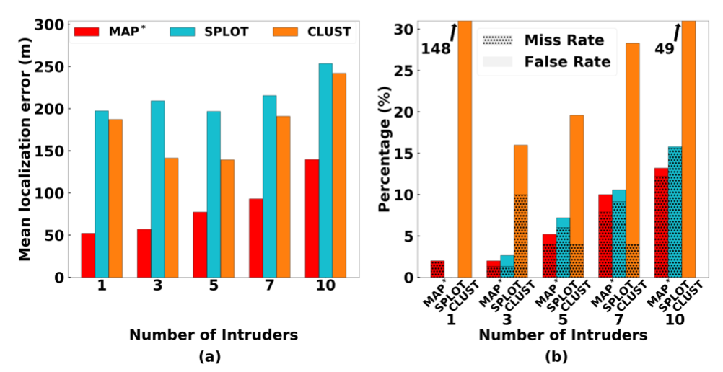
Evaluation – MAP*, Simulation
Compared with 1) Clustering-based solution, 2) SPLOT (MobiCom 2017)
Evaluation metric: localization error, miss and false alarm rate
MAP* (red bar) has lower localization error
and lower sum of miss rate and false alarm rate.
Notes:
Localization performance of various algorithms in a large scale simulation, for varying number of intruders

Slide 17
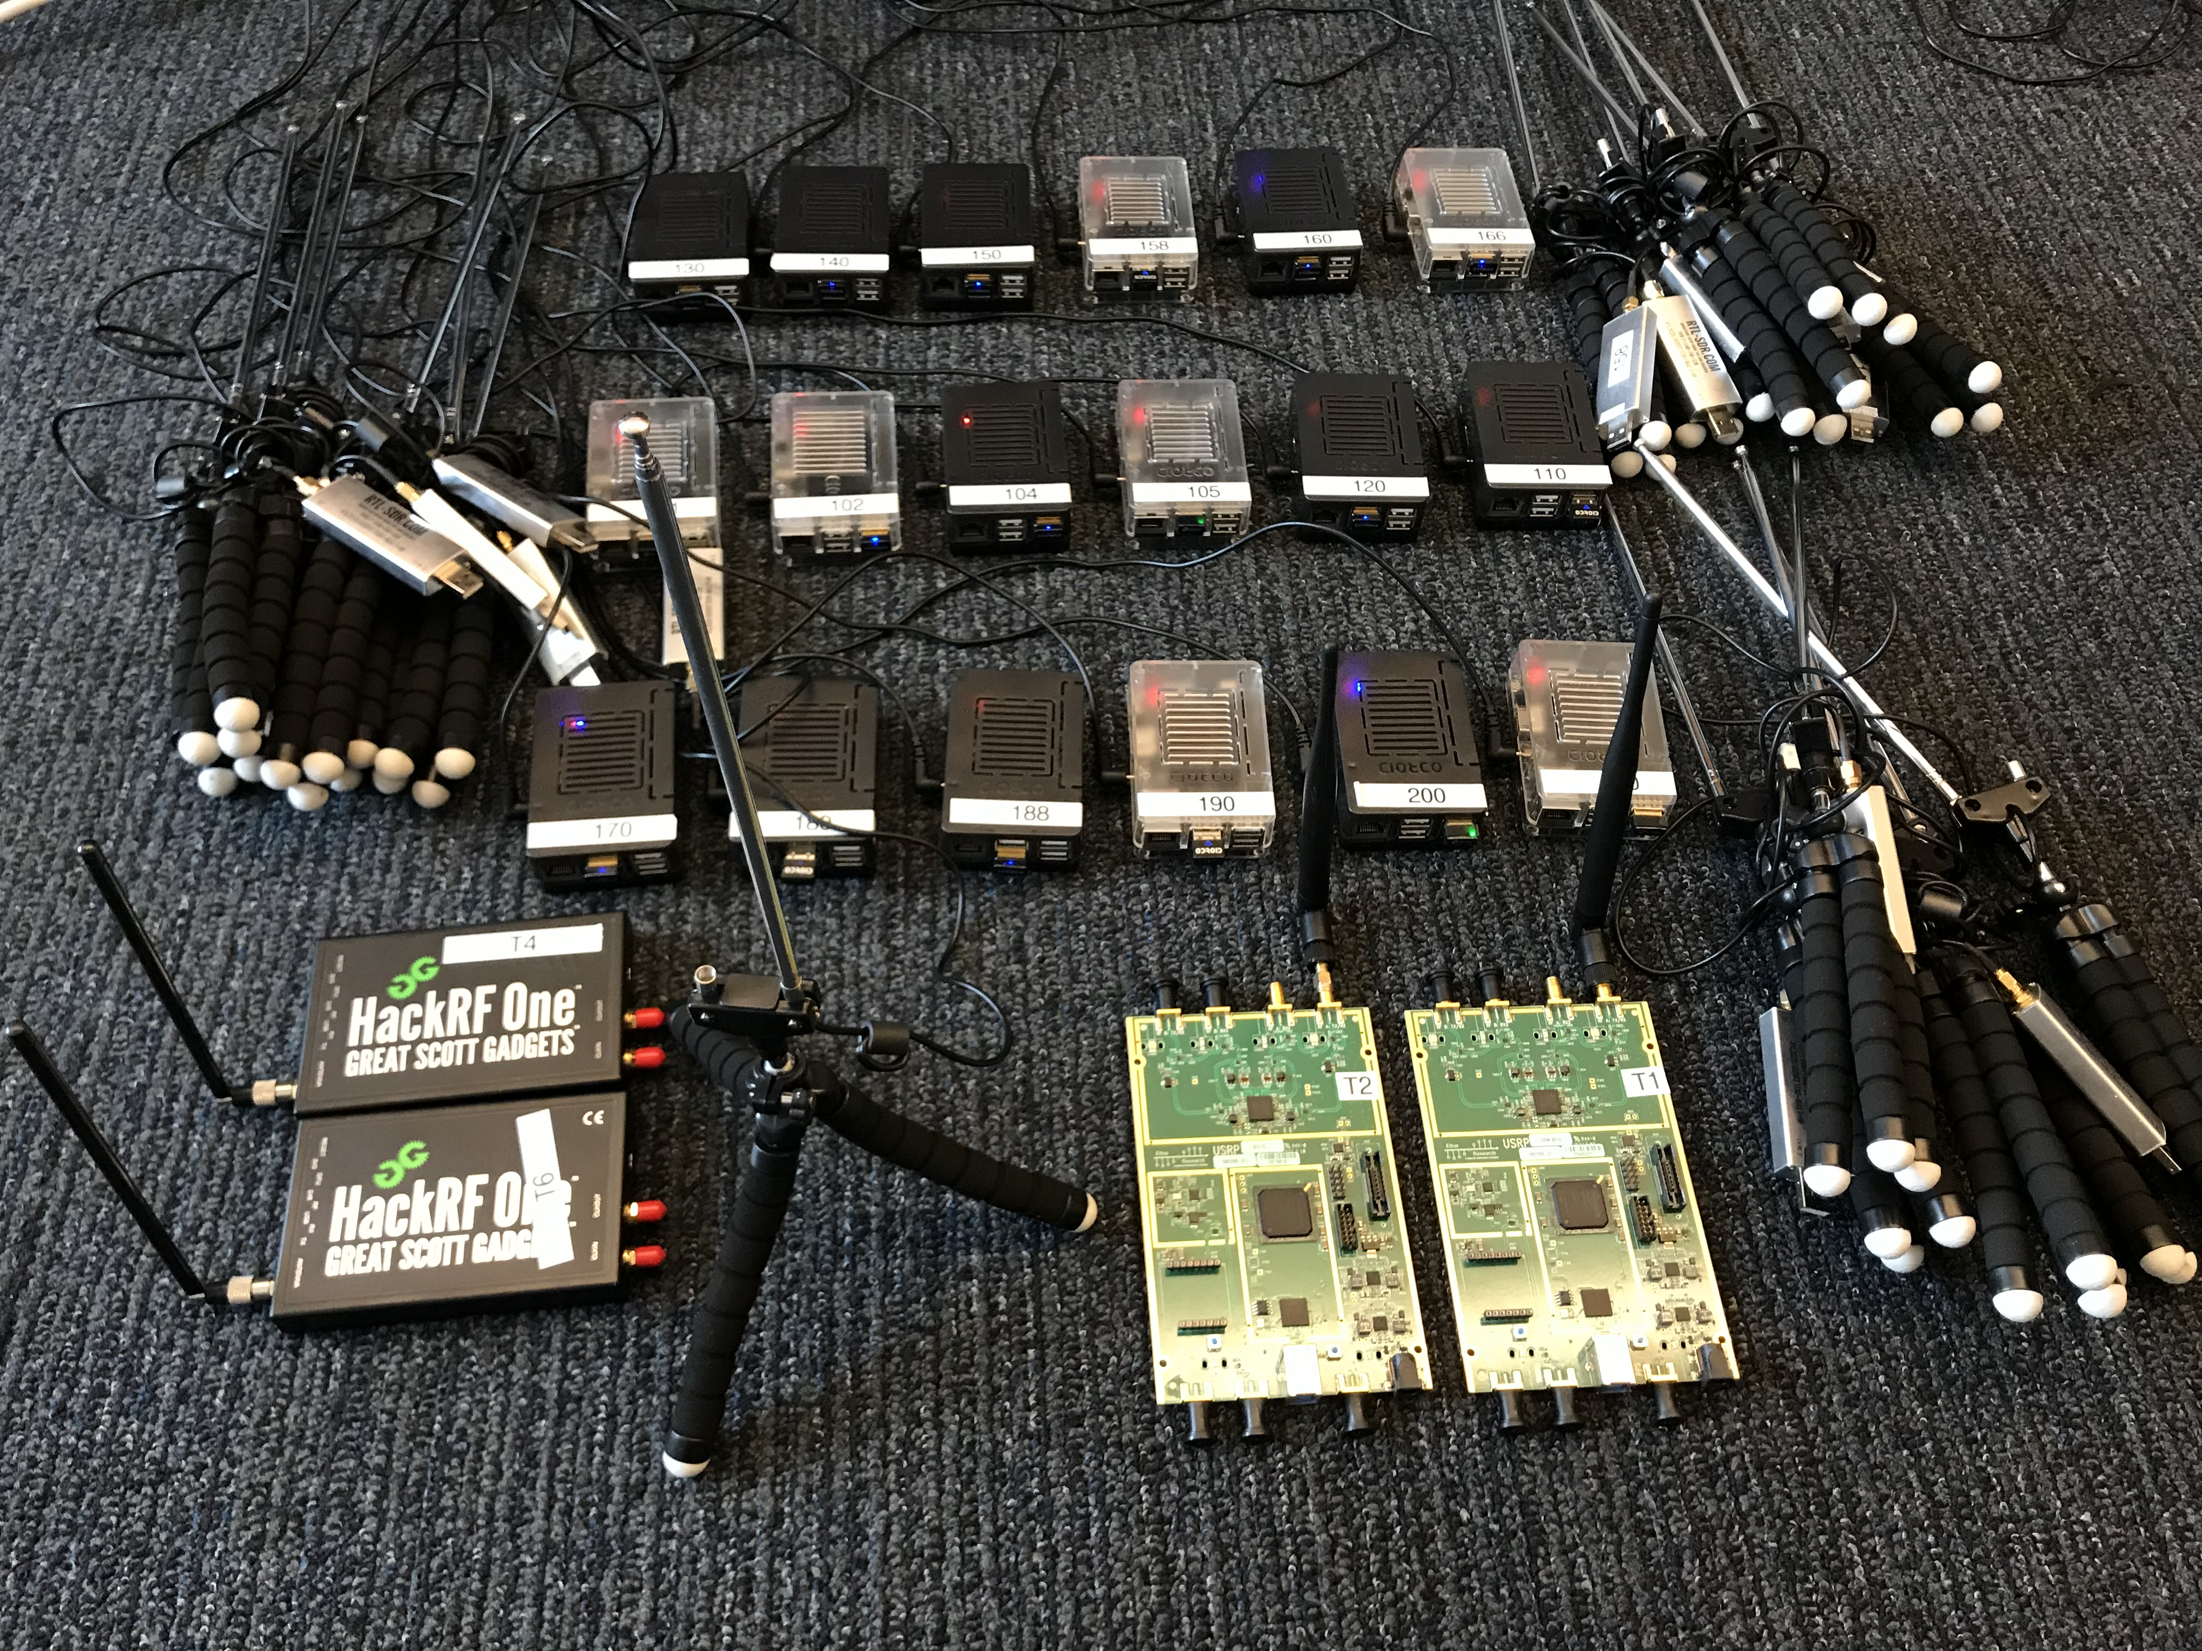
MAP*, Indoor Testbed
SDR devices and
single board computers
MAP* has lower localization error
and lower sum of miss rate and false alarm rate.
Notes:
Localization performance of varies algorithms in an indoor testbed, for varying number of intruders

Slide 18
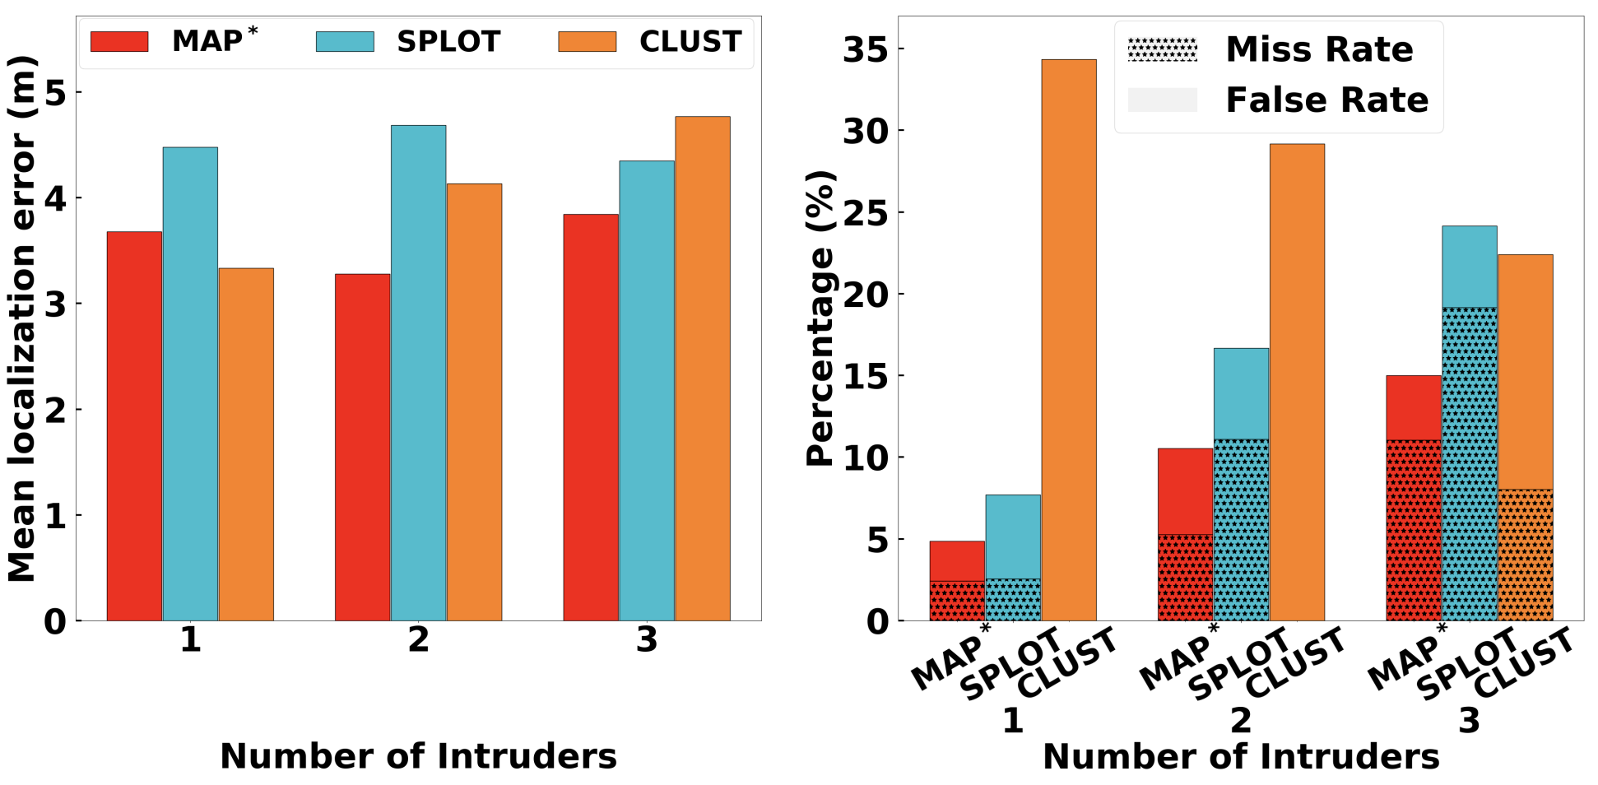
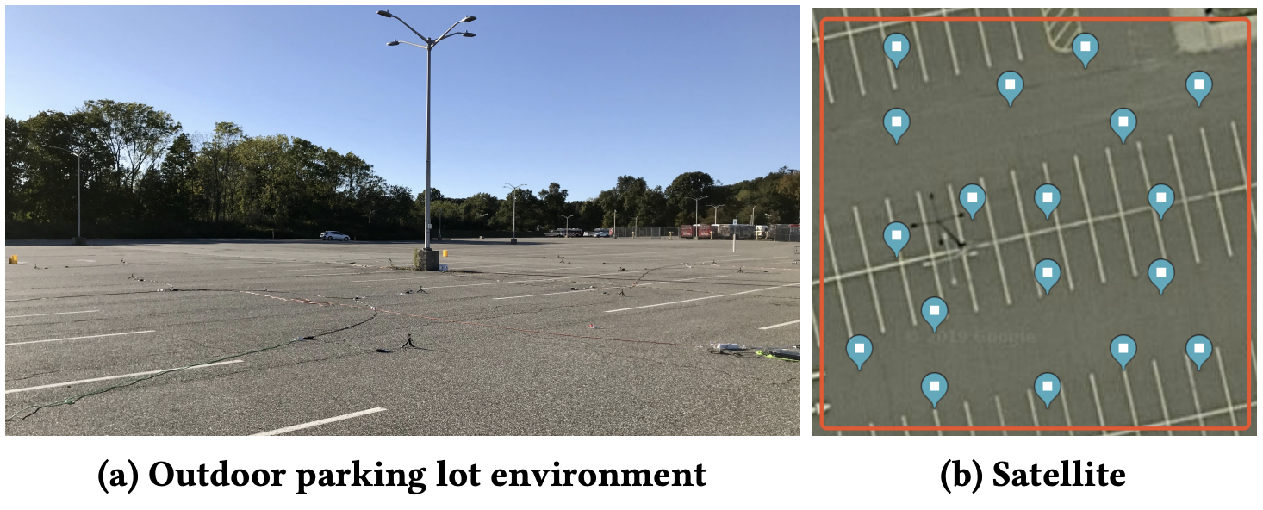
MAP*, Outdoor Testbed
MAP* has lower localization error
and lower sum of miss rate and false alarm rate

Slide 19
Part 1.2 -- DeepMTL: Deep Learning Based Multiple Transmitter Localization (WoWMoM 21, PMC 22)
Same background and problem
Use deep learning for performance improvement
Notes:
The sensors will sense the wireless channel of interest and process the wireless signals. Then sensors compute the received signal strength.

Slide 20
Core Idea: a Two Step CNN-based Method
Input
sensor1: (x1, y1, RSS1)
sensor2: (x2, y2, RSS2)
sensor3: (x3, y3, RSS3)
…
Step 1
Represent the sensor input as an image
Apply image-to-image translation CNN model
Step 2
Output
Tx1: (x1, y1)
Tx2: (x2, y2)
Apply object detection CNN model

Slide 21
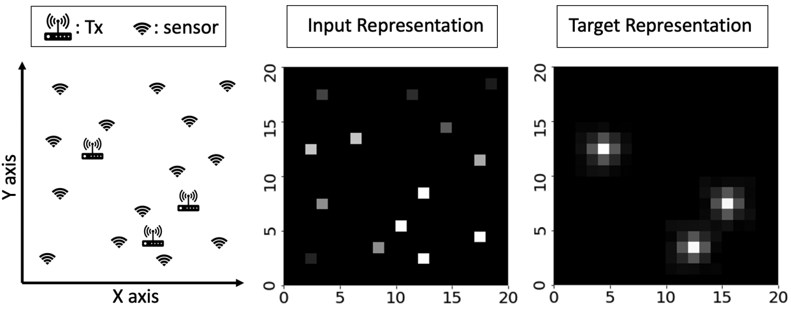
Step 1: Image to Image Translation
Input / Output Representation
translation
Gaussian
Peak
Notes:
Map one sensor to a pixel in the input representaiton

Slide 22
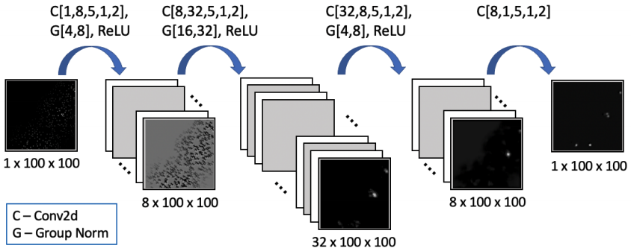
Step 1: Image to Image Translation
sen2peak: the CNN model
4 layers
Loss function
Notes:
C[input-channel, output-channel, kernel-size, stride, padding]
G[number-of-groups, number-of-channels]

Slide 23
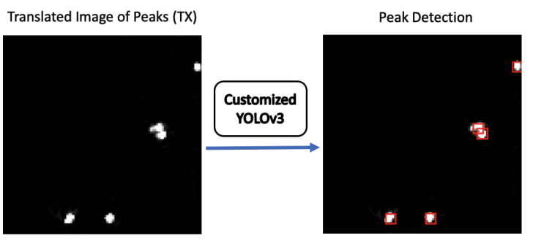
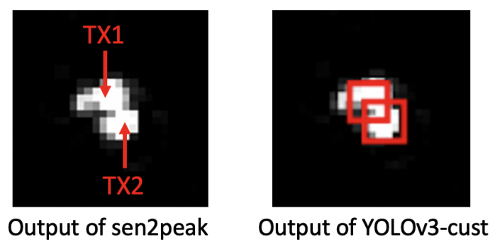
Step 2: Peak Detection
YOLO (You Only Look Once): A popular object detection model.
Localizing objects in an image
TX’s distribution is a peak. We view a peak as an object.
Peak detection is object detection
We customize the YOLOv3 (106 layers) and introduces YOLOv3-cust
The output of YOLOv3-cust are the coordinates of the center of the red bounding boxes
Notes:
A simple way: use a local maxima-based method (maximum pixel value within a circle of a certain radius)
Problem: Setting the radius value and the threshold for peaks is ad-hoc
Need a more intelligent method.

Slide 24
Evaluation -- Setup
Data generated using a simulator called SPLAT!
~100K samples for training and ~20K samples for testing
Area = 1km x 1km, grid = 100 x 100, cell = 10m x 10m
Performance metrics:
Localization error
Miss rate / False alarm rate

Slide 25
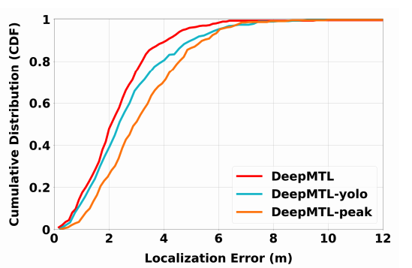
Compare Localization Error of Three Different Step 2 Methods (sharing the same step 1)
DeepMTL: use customized YOLOv3
DeepMTL-yolo: use the original YOLOv3
DeepMTL-peak: use naive peak detection

Slide 26
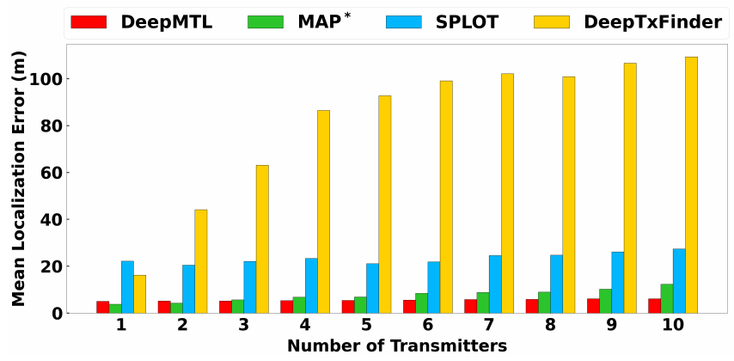
Compare Localization Error (Varying # of TX)
Compare our proposed DeepMTL with MAP*, SPLOT and DeepTxFinder

Slide 27
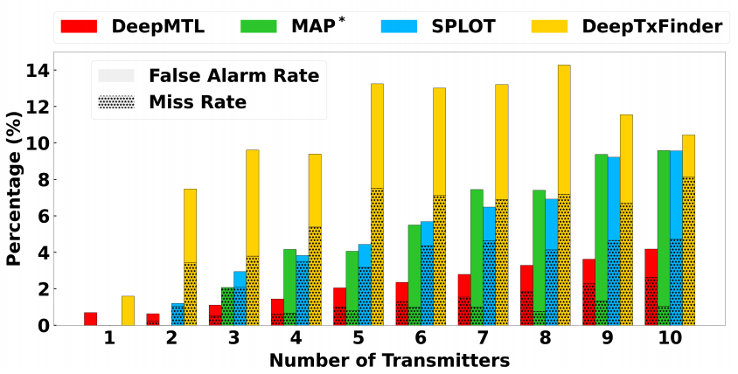
Compare Miss & False Alarm rate (Varying # of TX)
Compare our proposed DeepMTL with MAP*, SPLOT and DeepTxFinder

Slide 28
Part 1 Conclusion
Developed an efficient method based on Bayesian and Divide & conquer for the multiple intruder localization (MTL) problem
Designed and implemented a novel 2-step deep learning based approach named DeepMTL for the multiple transmitter localization problem
The evaluation results show that our methods outperforms the prior work by a large margin.

Slide 29
Table of Contents
Content | Paper | Time
Part 0: Introduction & Motivation |  | 8 min
Part 1: Transmitter Localization in classical sensor networks | ACM/IEEE IPSN 2020 IEEE WoWMoM 2021 Elsevier PMC 2022 | 16 min
Part 2: Transmitter Localization in quantum sensor networks | IEEE QCE 2023 | 14 min
Part 3: Optimizing Initial State in quantum sensor networks | ACM TQC (under revision) | 14 min
Summary

Slide 30
Part 2: Quantum Sensor Network Algorithms for Transmitter Localization (IEEE QCE 2023)
Given $|ψ⟩$ from the quantum sensor network, localize a single TX
Location?
Qubits: a complex
value vector of size $2^{n}$
Quantum Sensor
Transmitter
Quantum Sensor

Slide 31
Intro: Quantum Measurement
A quantum mechanics postulate, defined by some operators
If the measurement is carried on a pure state $|φ⟩$, we see the outcome $i$ with probability
General quantum measurement is described by positive operator-valued measure (POVM) $\{E_{i}\}$

Slide 32
Intro: Quantum State Discrimination (QSD)
Preparation
Discrimination
$$0$$
$$1$$
$$n$$
$$|φ⟩$$
$$0$$
$$1$$
$$n$$
measurement
Preparation: Pick a quantum state $|φ⟩$ from a target set
Discrimination: Determine what $|φ⟩$ is by measuring it
Picked $|φ_{1}⟩$
Measured as $|φ_{1}⟩$
Picked $|φ_{1}⟩$
Measured as $|φ_{2}⟩$

Slide 33
Problem Definition of TX Localization in QSN
A transmitter and distributed set of quantum sensors (QSN) in an area
QSN in an initial state of $|ψ_{0}⟩$
QSN evolve into a final state $\left|ψ_{t^{′}}\right\rangle =\hat{U}|ψ_{0}⟩$ under the impact of a transmitter over a period of $t^{′}$, where $\hat{U}$ models the quantum sensing
Estimate the location of the transmitter based on final state $\left|ψ_{t^{′}}\right\rangle$

Slide 34
Related Work
“Distributed Quantum Sensing Network with Geographically Constrained Measurement Strategies”, Yingkang Cao & Xiaodi Wu, IEEE ICASSP 2023
Local measurement
“Discrete Outcome Quantum Sensor Networks”, Mark Hillery & Himanshu Gupta & Caitao Zhan, Physical Review A, 2023
Global measurement, estimate discrete parameters
Precursor work of Part 2 and Part 3
Part 2 attempts to explore QSN towards real life application (TX localization)
Notes:
teleportation to central node

Slide 35
Quantum Sensing Model
$\hat{U}$: operator that models the impact of a signal to a quantum sensor
For impact on multiple sensors, do tensor product, ${\hat{U}=⊗}_{j=1}^{m}{\hat{U}}_{j}$
Assume Hamiltonian is a function of electric field $E; E$ is a function of distance ($E∼\frac{1}{d}$) $→$ connection between $\hat{U}$ and $d$ can be built
Notes:
Intuition: The further the distance from the TX to the sensor, the weaker the impact from the TX to the sensor
The electric field amplitude ($E$) will decrease as the signal travels further in space

Slide 36
Quantum Sensing – Phase Shift
The key quantity: phase shift picked up by the quantum sensor due to interaction with the signal [1]
Time evolution operator $\hat{U}\left(0, t^{′}\right)$ due to a signal $V(t)$:
$$\hat{U}\left(0, t^{′}\right)=e^{\frac{i}{ℏ}\int_{0}^{t^{′}}{{\hat{H}}_{V}\left(t\right)dt}}$$
$=$ $e^{\frac{i}{ℏ}\int_{0}^{t^{′}}{− \frac{1}{2}γV_{∥}\left(t\right){\hat{σ}}_{z} dt}}$
$=e^{\frac{i}{ℏ}\int_{0}^{t^{′}}{− \frac{1}{2}γE\sin\left(2πft+θ\right){\hat{σ}}_{z} dt}}$
$=e^{− \frac{i}{2}φ{\hat{σ}}_{z}}$
Phase shift, $φ$, accumulated during sensing time $[0, t^{′}]$ due to the signal [1]:
$$φ=\frac{2}{πℏ}γEt^{′}$$
[1] Quantum Sensing, C. Degen & F. Reinhard & P. Cappellaro, Review of Modern Physics 2017
Notes:
$γ$ is the coupling of the qubit to the signal

Slide 37
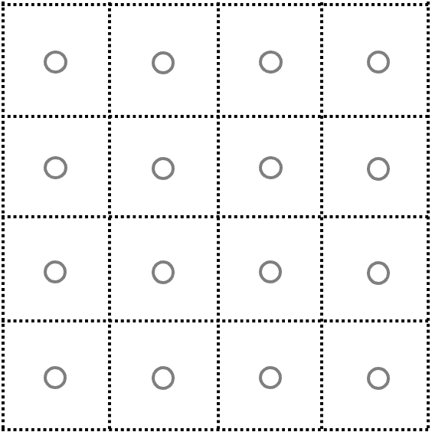
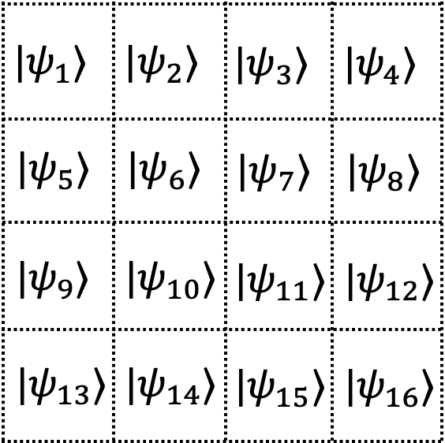
Methodology: TX Localization as QSD
Pose the TX localization problem as the quantum state discrimination (QSD)
Observation: Different locations of TX will result in different final states
Key idea: by determining the final state (via QSD), we get the TX location
[1] Quantum State Discrimination and Its Applications, J. Bae, J. Phys. A: Math. Theor., 2015
Notes:
Underlies various applications in quantum information processing
Describes the distinguishability of quantum systems in different states, and the process extracting information from quantum system.

Slide 38
One-Level QSD Method
The quantum sensor network is in initial state $|ψ_{0}⟩$
Create the set of final states $\{|ψ_{i}⟩\}$ corresponding to the center of grid cells.
Generate the POVM $\{E_{i}\}$ on the final states $\{|ψ_{i}⟩\}$ using Pretty Good Measurement [1]
Localize the TX by a QSD over the final state using POVM $\left\{E_{i}\right\}$. Multi-shot, select most frequent outcome
[1] A ’Pretty Good’ Measurement for Distinguishing Quantum States, Paul Hausladen et al, Journal of Modern Optics 1994

Slide 39
Improve: Parameterized Quantum Circuits
QSD-based method is good in theory, but…
POVM $\{E_{i}\}$ is hard to implement on gate-based quantum machines
QSD-based method is limited to discrete TX locations
Solution:
POVM $→$ parameterized quantum circuits
Learn the parameters via training (a.k.a. quantum machine learning)
Add a fully connected layer that can output in either discrete or continuous space (via different labels and loss function)
Notes:
High PoE: assign a single outcome to a set of target locations

Slide 40
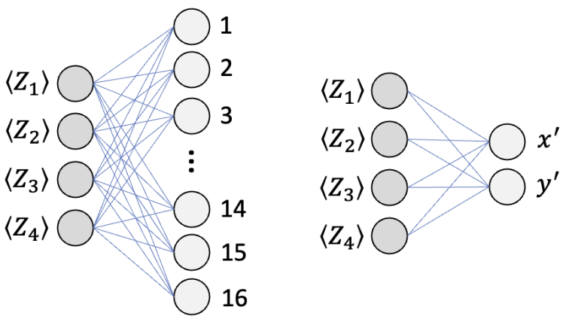
PQC-based Localization
Quantum part: blocks of $U_{3}$ and ${CU}_{3}$
Classical part:
Process the measurement outcomes, i.e., $\left\langle Z\right\rangle$
Neural network location predictor
Classifier
Regression
Notes:
measurement: compute the expected value of the z operator (measurement)
overall circuit with the Classifier component for the location prediction essentially equates to a circuit for quantum state discrimination (QSD), as the QSD problem also outputs a finite number of discrete outcomes
To output the predicted location in the continuous 2D space, we use a Regression Variant that outputs the location as an (x, y) point.

Slide 41
Evaluation Setting
Area $→$ grid
Cell size: $10m × 10m$
Grid size: $2×2$ to $16×16$
TX signal’s electric field model:
$E=\frac{\sqrt{30⋅P}}{d}×(1+noise)$ [1]
$P$: power of the TX $=0.1μW$
$d$: is the distance between TX and sensor
$noise$: wireless propagation noise, zero mean gaussian
Sensor setting:
Initial state: Uniform superposition state
Number: 4, 8, 16
Uniformly distributed
TX Location:
Continuous : anywhere in the grid – Average localization error $(m)$
Discrete : only at cell centers – Cell classification accuracy $(\%)$
[1] Field strength meter, https://en.wikipedia.org/wiki/Field_strength_meter
Notes:
Evolution time = 1 ms
Less than one micro watt

Slide 42
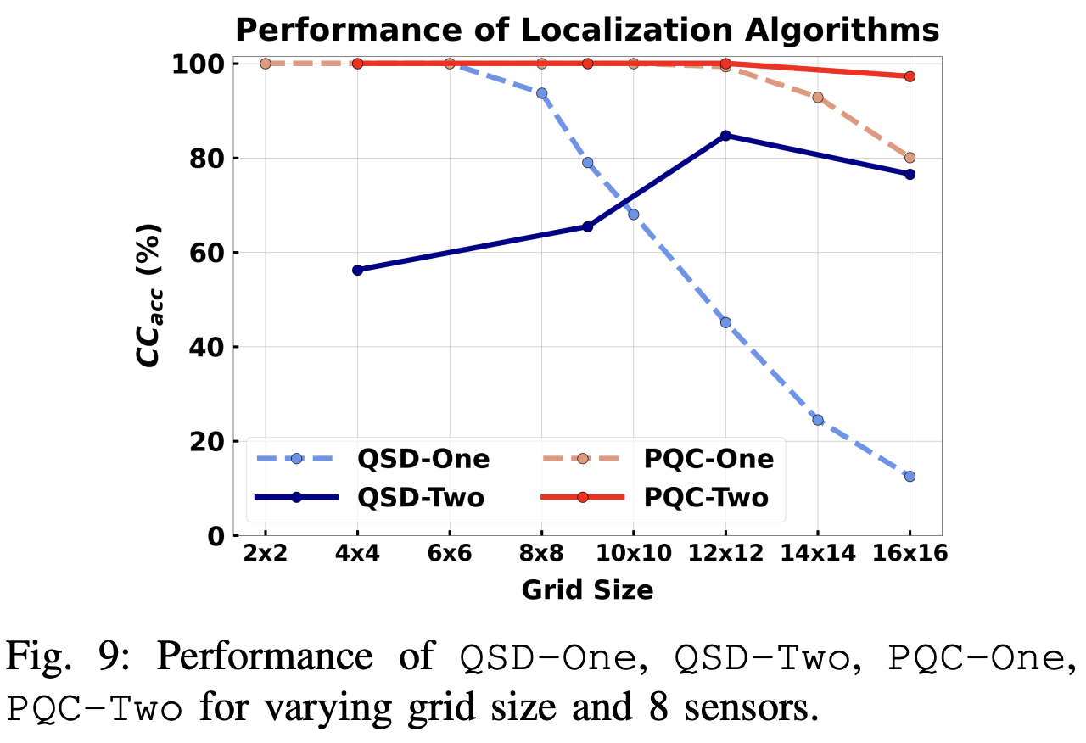
Evaluation Result
The PQC-based is better than QSD-based method
Two level approach can improve the localization performance

Slide 43
Conclusion & Discussion
A first step using QSN in a real-world application – localization of TX
Pose the TX localization problem as quantum state discrimination
TX Localization using QSN: meter level localization accuracy ($∼100m^{2}$)
Not better than using classical wireless sensors (yet)
But the TX power is very small $→$ classical sensor may not even detect it
Potential future directions:
Entangled initial state
A better/realistic Hamiltonian
New localization algorithms

Slide 44
Table of Contents
Content | Paper | Time
Part 0: Introduction & Motivation |  | 8 min
Part 1: Transmitter Localization in classical sensor networks | ACM/IEEE IPSN 2020 IEEE WoWMoM 2021 Elsevier PMC 2022 | 16 min
Part 2: Transmitter Localization in quantum sensor networks | IEEE QCE 2023 | 14 min
Part 3: Optimizing Initial State in quantum sensor networks | ACM TQC (under revision) | 14 min
Summary

Slide 45
Part 3: Optimizing Initial State of Detector Sensors in Quantum Sensor Networks (ACM TQC, revision)
A network of quantum sensors. Sensor’s output is binary (detect / no detect)
The sensor network is initialized in $|ψ⟩$
One sensor detects an input, i.e., impacted by a unitary U
The sensor network evolves into a final state $|φ⟩$
Task: Measure the final state $\left|φ\right\rangle$to figure out which sensor detected
Problem: The optimal initial state $|ψ⟩$ for the quantum sensor network?
Need to consider the quantum measurement too
Initial State?
Measurement?
Sensor #$i$ detected
Notes:
Binary: (detects an input / does not detect an input)

Slide 46
$U$ – Interaction between Input and Sensor
the rotation of a spin caused by a magnetic field
a phase shift induced in a state of light by a transparent object
$$U$$
…
Assume $U$ is eigen-decomposed as $U\left|u_{±}\right\rangle =e^{±iθ}\left|u_{±}\right\rangle$

Slide 47
Final States
$$n$$
Sensors
$$φ_{0}$$
$$φ_{1}$$
$$U$$
$$φ_{i}$$
$$i$$
$$φ_{n−1}$$
$|ψ⟩$
Initial State
$$\{{|φ}_{i}⟩\}$$
N Final States
Final States
$$\left\{\left|φ_{i}\right\rangle \right\} = \left\{ (I^{⊗i}⊗U⊗I^{⊗\left(n−1−i\right)}) | ψ\right\rangle | 0≤i<n\}$$
$$\left|φ_{0}\right\rangle =\left(U⊗I⊗I\right)|ψ⟩$$
$$n=3$$
$$\left|φ_{1}\right\rangle =\left(I⊗U⊗I\right)|ψ⟩$$
$$\left|φ_{2}\right\rangle =\left(I⊗I⊗U\right)|ψ⟩$$

Slide 48
Apply QSD to our Problem
We model a quantum sensor network using techniques from quantum state discrimination (QSD)
Figuring out which sensor detects $→$ Quantum state discrimination (QSD) against the N final states
The QSD outcome tells which sensor detected an input
$$φ_{0}$$
$$φ_{1}$$
Quantum Sensor Network
Quantum State Discrimination
$$i$$
$$φ_{i}$$
Detected Sensor
$$φ_{n−1}$$
$$\{{|φ}_{i}⟩\}$$
N Final States
POVM

Slide 49
Semidefinite Programming
Given N final states $\{{|φ}_{i}⟩\}$, designing an optimal POVM such that discriminating the N final states has a minimal error:
Numerically solvable via semi-definite programming (SDP) [1]
The solver (CVXPY) will give you
POVM, i.e., measurement operators
objective value – minimal probability of error
Initial State?
SDP
Objective value
Heuristic algorithm to search for the optimal initial state!
[1] Designing optimal quantum detectors via semidefinite programming, Y.C. Eldar, IEEE Trans. Information Theory, 2002

Slide 50
Heuristic Search Algorithms
Initial state $|ψ⟩$ search space: A complex value array $x$
$len\left(x\right)=2^{n},$ where $n$ is the number of sensors (one qubit per sensor)
$x^{†}x=1$
Hill Climbing:
Random $x$
Find some neighbors of $x$
Compute the objective value of the neighbors
The best neighbor is $x^{′}$. Let $x=$ $x^{′}$
Go back to step 2) until termination condition satisfied
Return $x$
Climbing
We also tried simulated annealing and genetic algorithm

Slide 51
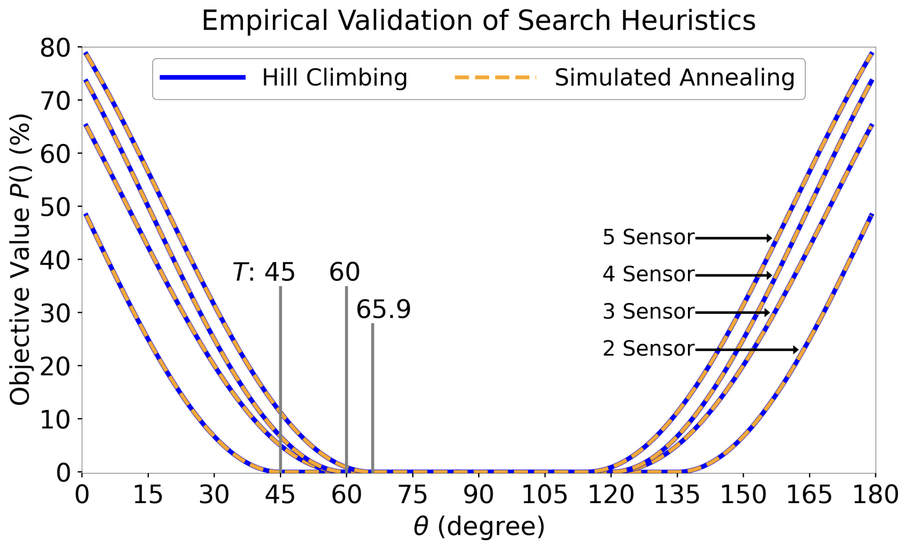
Results for Heuristic Search
Exist a $T$ such that in $[T,180−T]$, zero error in figuring out which sensor detects
exist an initial state such that the final states are mutually orthogonal
Note: $U\left|u_{±}\right\rangle =e^{±iθ}\left|u_{±}\right\rangle$

Slide 52
Expression for $T$
n | 3 | 4 | 5 | 6 | 7 | 8 | 9 | 10
T (degree) | 60 | 60 | 65.9 | 65.9 | 69.3 | 69.3 | 71.6 | 71.6
The larger the number of sensors, the larger the $T$
Notes:
What does larger T imply?
A larger T – a larger angle means U has a larger impact to the sensor
Larger number of n means it is harder for discrimination

Slide 53
2 Key Steps in Proof
$$U\left|u_{±}\right\rangle =e^{±iθ}\left|u_{±}\right\rangle$$
Construct new basis that are tensor products of $\left|u_{−}\right\rangle$ and $\left|u_{+}\right\rangle$
Partition the amplitude squares
${{S_{0}=\{ |ψ}_{0}|}^{2} \} due to \{|u_{−}u_{−}⟩$}
${{S_{1}=\{ |ψ}_{1}|}^{2}{{, |ψ}_{2}|}^{2} \} due to \{|u_{−}u_{+}⟩$, $|u_{+}u_{−}⟩\}$
${{S_{2}=\{ |ψ}_{3}|}^{2} \}$ $due to \{|u_{+}u_{+}⟩$}

Slide 54
$n=2$Case – Analysis
$U|u_{±}⟩=e^{±iθ}|u_{±}⟩$
Express $\left|ψ\right\rangle$ in the basis of $\{|u_{−}u_{−}⟩,|u_{−}u_{+}⟩$, $|u_{+}u_{−}⟩$, |$u_{+}u_{+}⟩$}, and the respective amplitudes are $\{ψ_{0},ψ_{1},ψ_{2},ψ_{3}\}$
Inner product $z=\left\langle ψ\left|U⊗U^{−1}\right|ψ\right\rangle =|{ψ_{1}|}^{2}e^{−2iθ}+|{ψ_{2}|}^{2}e^{2iθ}+(|{ψ_{0}|}^{2}+\left|{ψ_{3}|}^{2}\right)$
The possible values of $z$ are illustrated inside the red triangle below
$$imagine$$
$$e^{+2iθ}$$
$$1$$
$$real$$
$$e^{−2iθ}$$

Slide 55
$n=2$Case: Optimal
$$P_{success}^{opt}=\frac{1}{2}\left(1+\sqrt{1−{\left|\left\langle ψ\left|\left(U⊗U^{−1}\right)\right|ψ\right\rangle \right|}^{2}}\right)=\frac{1}{2}\left(1+\sqrt{1−{\left|z\right|}^{2}}\right)$$
maximize $P_{success}$ $→$ minimize $\left|z\right|$
minimize | $|{ψ_{1}|}^{2}e^{−2iθ}+|{ψ_{2}|}^{2}e^{2iθ}+(|{ψ_{0}|}^{2}+\left|{ψ_{3}|}^{2}\right) |$
$$0<θ<45$$
$$45≤θ<90$$
$$e^{+2iθ}$$
$$e^{+2iθ}$$
$$1$$
$$1$$
Optimal $z$
$$e^{−2iθ}$$
Optimal $z$
$$e^{−2iθ}$$
${|ψ}_{1}|=|ψ_{2}|=\frac{1}{\sqrt{2}}$ and ${|ψ}_{0}|=|ψ_{3}|=0$
$$P_{success}^{opt}=1$$

Slide 56
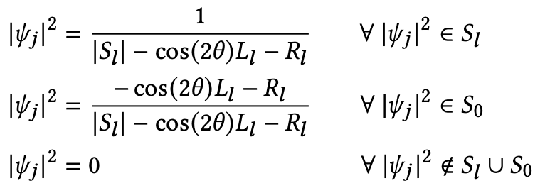
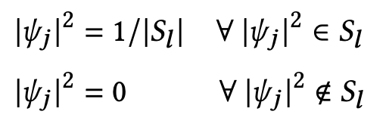
General $n$ Sensors, Optimal Initial State $\left|ψ\right\rangle$
$$T≤θ<\frac{π}{2}$$
$$0<θ<T$$
“Modification of Dicke State”
Dicke State!
$$\left|ψ\right\rangle =$$
$$\left|ψ\right\rangle =$$
$\left|D_{k}^{n}\right\rangle , k=n/2$ , $θ$ independent
$θ$ dependent
E.g., when $n=4$
E.g., when $n=4,θ=70 \text{degree}$
$\left|ψ^{opt}\right\rangle =\left|D_{2}^{4}\right\rangle =c_{1}(\left|0011\right\rangle +$ $\left|0101\right\rangle +$ $\left|0110\right\rangle +$
$\left|1001\right\rangle +$ $\left|1010\right\rangle +$ $\left|1100\right\rangle )$
Where $c_{1}=\frac{1}{\sqrt{6}}≈0.41,$ $\left|0\right\rangle$ is $|u_{−}⟩$ and $\left|1\right\rangle$ is $|u_{+}⟩$
$\left|ψ^{opt}\right\rangle =c_{1}(\left|0011\right\rangle +$ $\left|0101\right\rangle +$ $\left|0110\right\rangle +$
$\left|1001\right\rangle +$ $\left|1010\right\rangle +$ $\left|1100\right\rangle )+c_{2}|0000⟩$
Where $c_{1}≈0.37,c_{2}≈0.39, \left|0\right\rangle$ is $|u_{−}⟩$ and $\left|1\right\rangle$ is $|u_{+}⟩$
Optimality near proved
Optimality proved
Notes:
Dicke state $\left|D_{k}^{n}\right\rangle =\frac{1}{{\left({n \atop k}\right)}^{2}}\sum_{x∈{\left\{0,1\right\}}^{n}, wt\left(x\right)=k }{|x⟩}$
>T proof: letting the pairwise inner products equal zero
<T proof: symmetry of coefficient

Slide 57
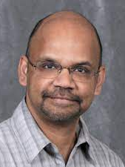
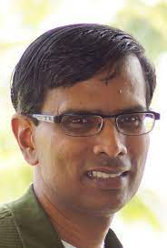
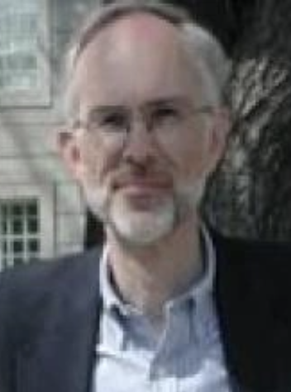
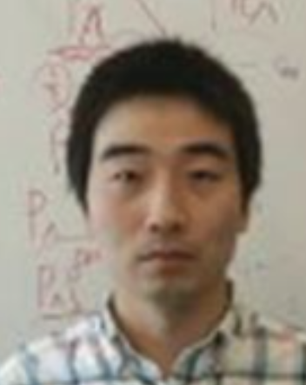
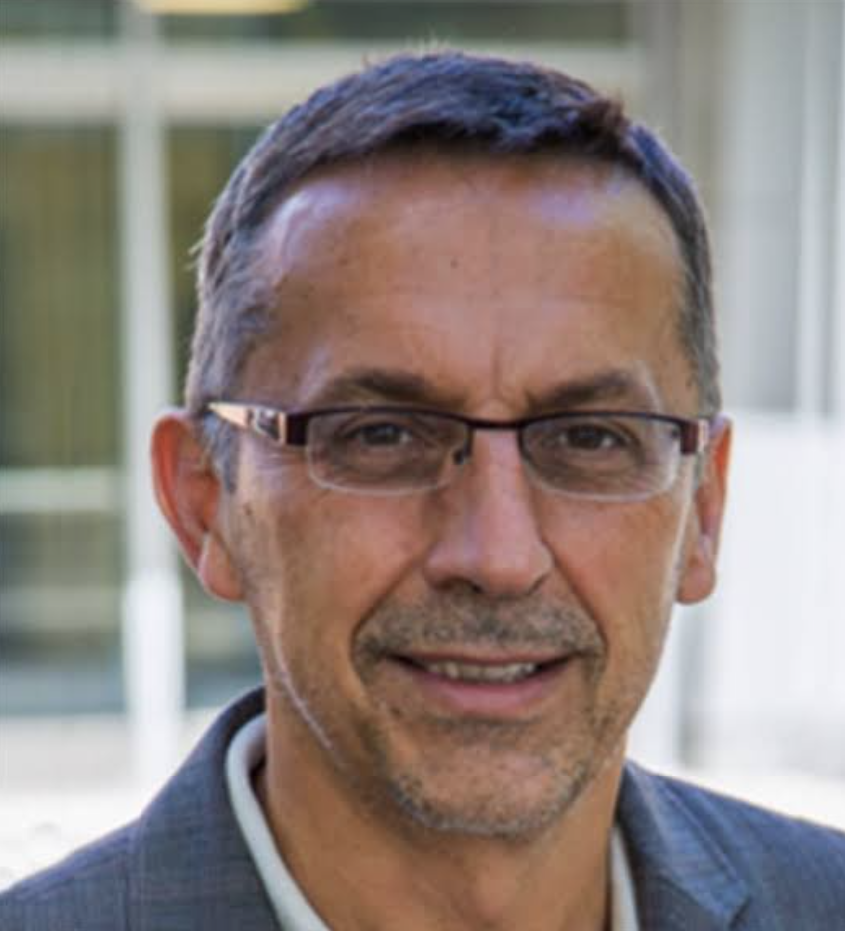
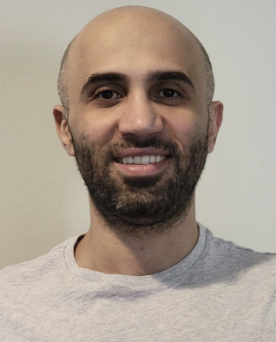
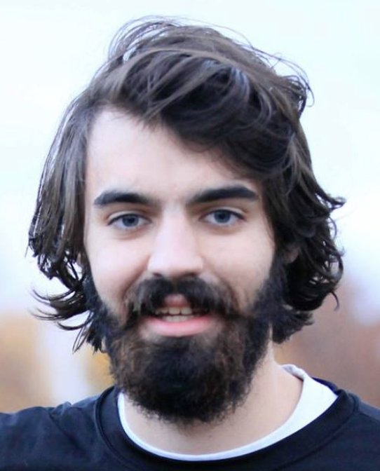
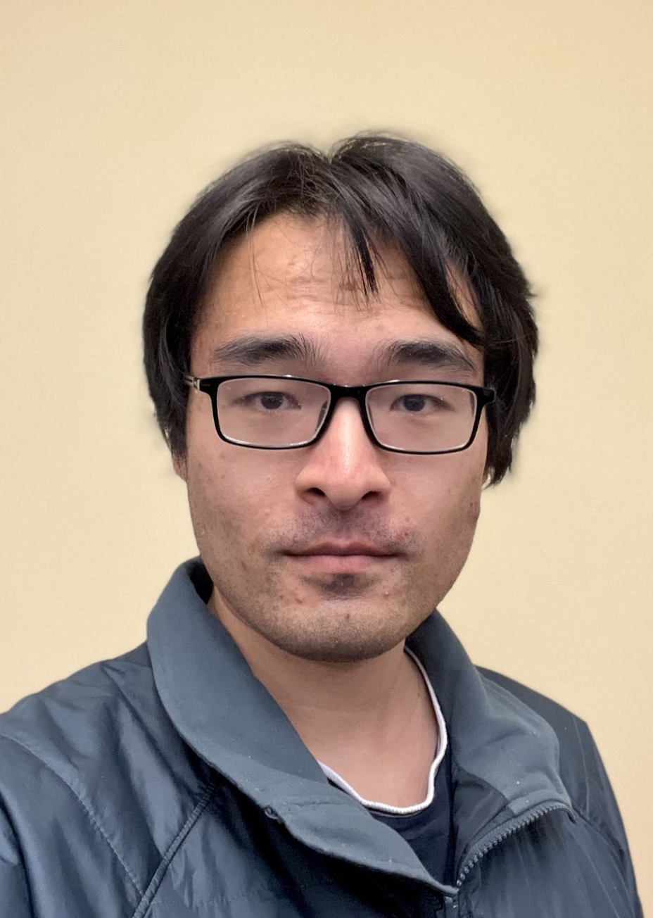
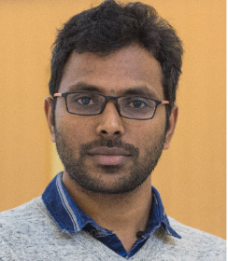
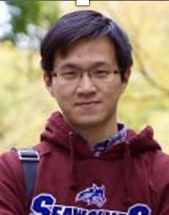
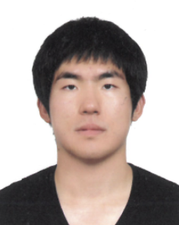
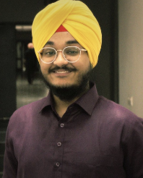
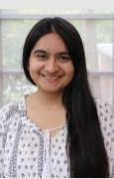
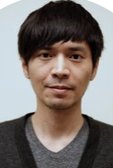
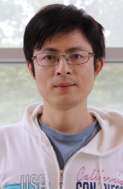
Acknowledgement
Committee:
Coauthors:
Many more!

Slide 58
Summary – 3 Topics
Multiple transmitter localization in classical sensor networks
Transmitter localization in quantum sensor networks
Initial state optimization for detector sensors in quantum sensor networks
Thank you for listening!

